Slide 1
NLP IN HOTEL REVIEWS
Smart-Dec
2016-12-25

Slide 2
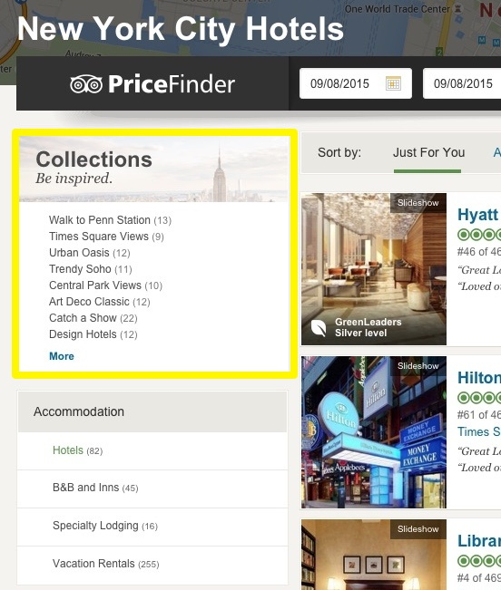
Extract Interesting Themes Among NYC Hotels
At the moment, there are 1790 hotels listed for Paris, 1054 hotels for London, and 466 hotels in New York City.
Natural Language Processing (NLP) help to find groups of hotels that have an interesting theme.
It is a semi-automated process that can be scaled across many cities.

Slide 3
Workflow
Raw material
Vectors
Themes
Phrases
SegPhrase
Word2vec
Agglomerative clustering

Slide 4
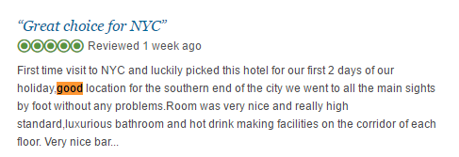
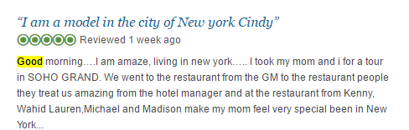
Raw Material To Phrases
Traditional NLP use “word to word” understanding base on frequency of words, but a single word is not expressive, and it is misleading often and often.
For example, we can’t tell the “good” is the part of “good location” or simple a “good morning”.

Slide 5
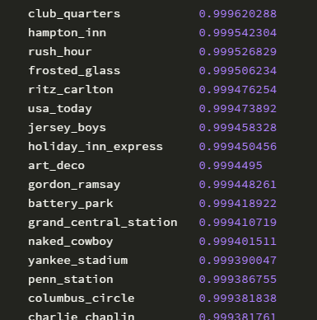
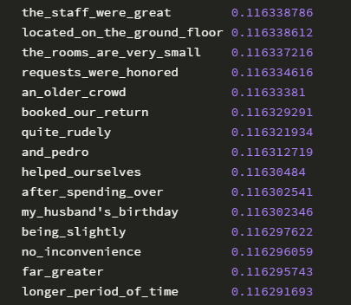
Raw Material To Phrases
Since single words aren’t very expressive, we wanted to find some good phrases in our review text.
We tried the approach “SegPhrase” from paper “Mining Quality Phrases from Massive Text Corpora”.
It is a multiple step process, but the output is that you get a large set of phrases, and a score on how likely it is to be a phrase.
We dubbed this score the “phrasiness” metric.
All of these are clear semantic concepts, not just a sequence of words that frequently co-occur.

Slide 6
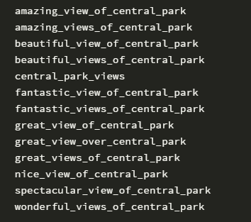
Word2vec Tricks
We have a bunch of phrases, and many of them are very similar. These phrases …
Seem like a great basis for making a hotel collection. But they are mixed in with tens of thousands of other phrases. It would be very helpful to cluster the related phrases into groups.
But what features should we use to do the clustering?
We need a similarity metric that puts these phrases close to each other.

Slide 7
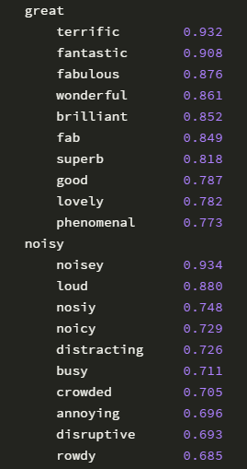
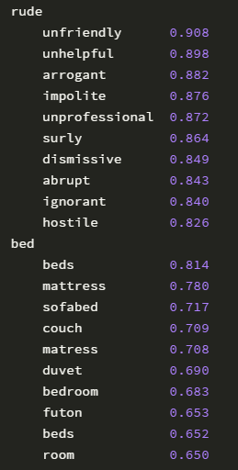
Word2vec Tricks
The word2vec algorithm from Mikolov and other Google researchers is perfect for this case.
Given a corpus of text, it maps each word into a numerical vector of say 100 dimensions.
The mapping is done in a way that put words that are used in a similar way in the corpus are near each other in the vector space.

Slide 8
Clustering Phrases Into Tight Topics
Usually, in a clustering problem we are interested in all of the clusters.
Here, we have a slightly different situation. We want to group similar keywords into very focused groups, like our “view of central park” phrases one the right.
We chose the agglomerative clustering routine.Agglomerative clustering starts with each phrase in its own cluster, so we have N clusters of size 1. It then goes through and tries to combine each pair of current clusters into a new combined one.

Slide 9
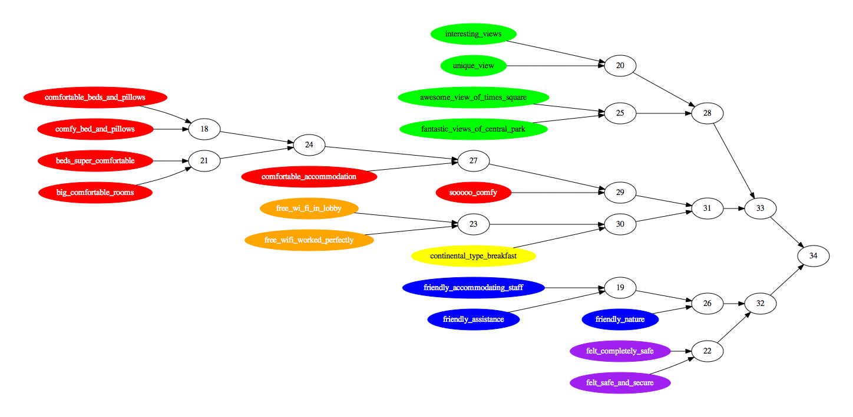
Let’s look at an example for our New York city hotel data. We chose 18 phrases, such that they formed some natural clusters. There are 4 keywords about the view, 6 about being comfortable, 2 about the wi-fi, 1 about breakfast, 3 about friendly staff, and 2 about feeling safe.
With luck, the phrases should be clustered into these natural clusters at some point. Here is the clustering, with the natural clusters shown as different colors.
The score of the combined cluster is the maximum of the distances between every pair of phrases in the combined cluster.

Slide 10
The Human Curation Post-Process
Up to this point we have had a totally automated process, that use phrase detection, word2vec features, and agglomerative clustering to find clusters of phrases. The remaining step is to find the interesting ones. At this point we rely on human curation to pick out the interesting ones, and give them a snappy name.
The manual process is fairly easy. We provide a list of phrases for a cluster, the hotels that are the most related to the cluster, even some examples sentences from the review text for those hotels. It is fairly easy to look at that information, and determine if it would a good way to explore the hotels of a city. It is hard to mathematically define what is interesting, but easy for a human to know when they see it. The human also comes up with a clever name, which is also simple given the list of phrases.

Slide 11
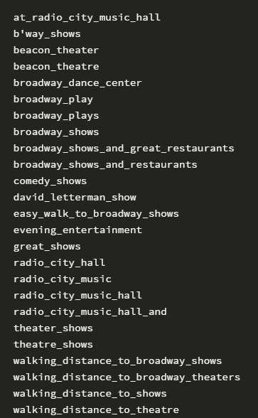
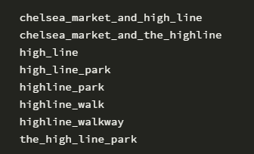
Some Interesting Collections
The “Catch a Show” collection has phrases like this:
The “Near The High Line” collection has:

Slide 12
The Final Output
Finally, we can create collections of hotels sharing the same topics.
Beyond simple ratings, we now can describe hotels with meaningful and localized subjects.

Slide 13
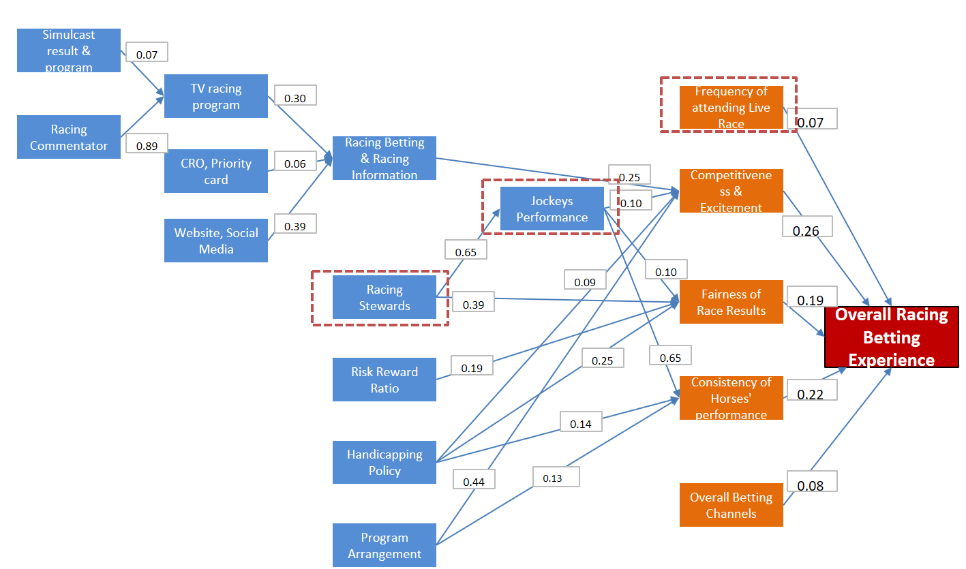
The Analysis of Variance
What can we learn from HKJC customer reviews?
NLP model can extract a cluster structure similar to SEM model on HKJC questionnaires.
Without questionnaires design and collecting, NLP model much lower.
Topics are grouped automatically base on similarity, no need for tuning tons of model parameters comparing to SEM model.

Slide 14
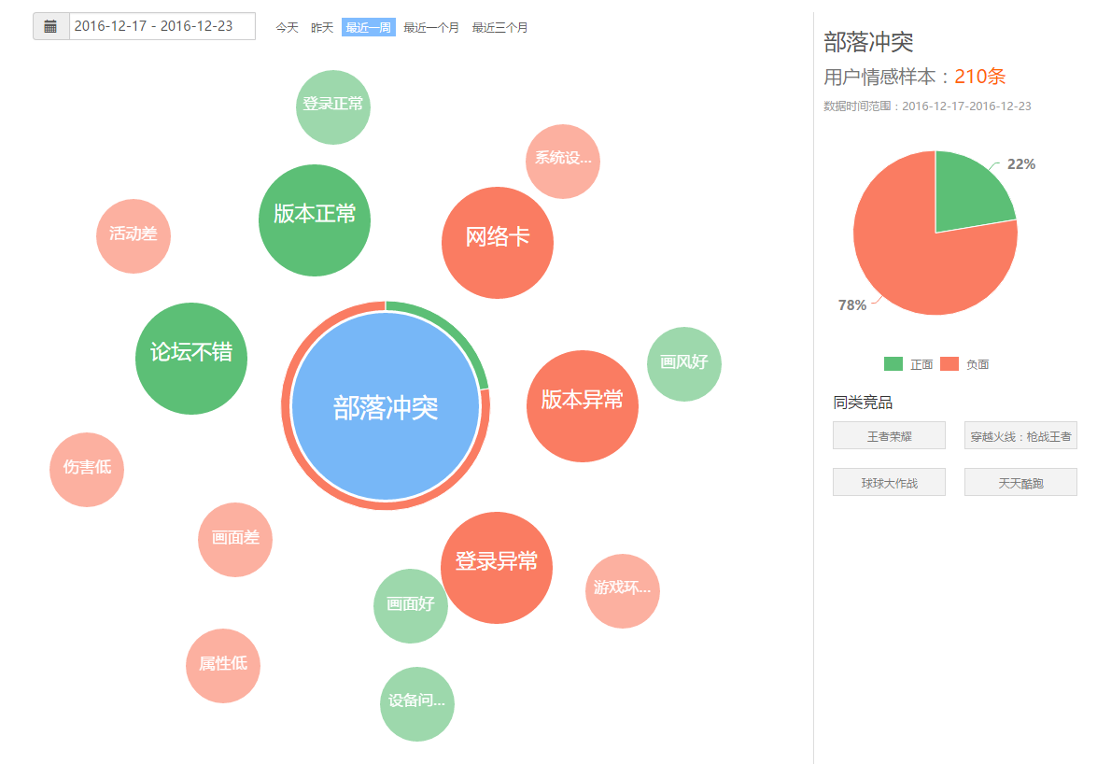
The Analysis of Variance
Topics mining on reviews reflects customers satisfaction.
Topics will change over time.
Customers reviews on various clubhouses may focus on different topics.
Customers of different membership may show different preference.

Slide 15
Thank you

